Slide 1
Refactoring & Testing with the Visual Studio & C#
Halil İbrahim Kalkan
https://github.com/hikalkan/presentations
(https://bit.ly/2OSYGze)

Slide 2

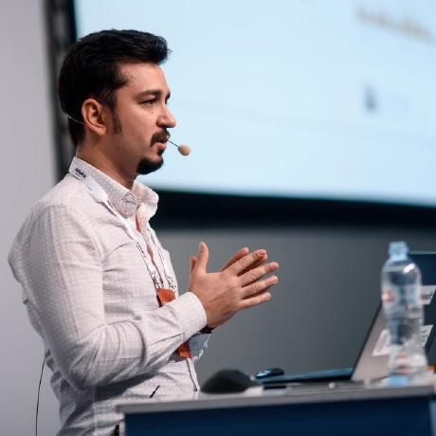

Halil İbrahim Kalkan
Co-Founder of
Github: @hikalkan
Twitter: @hibrahimkalkan

Slide 3
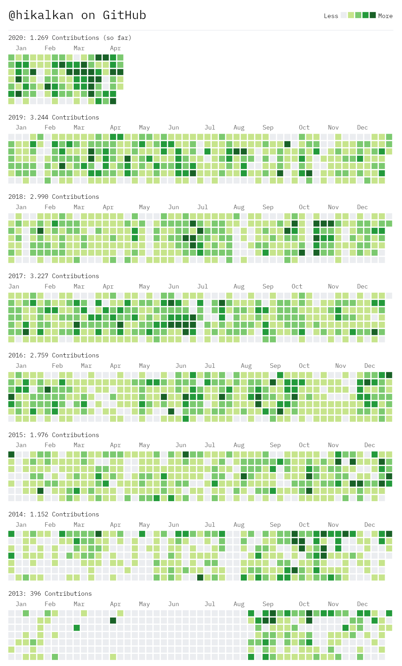
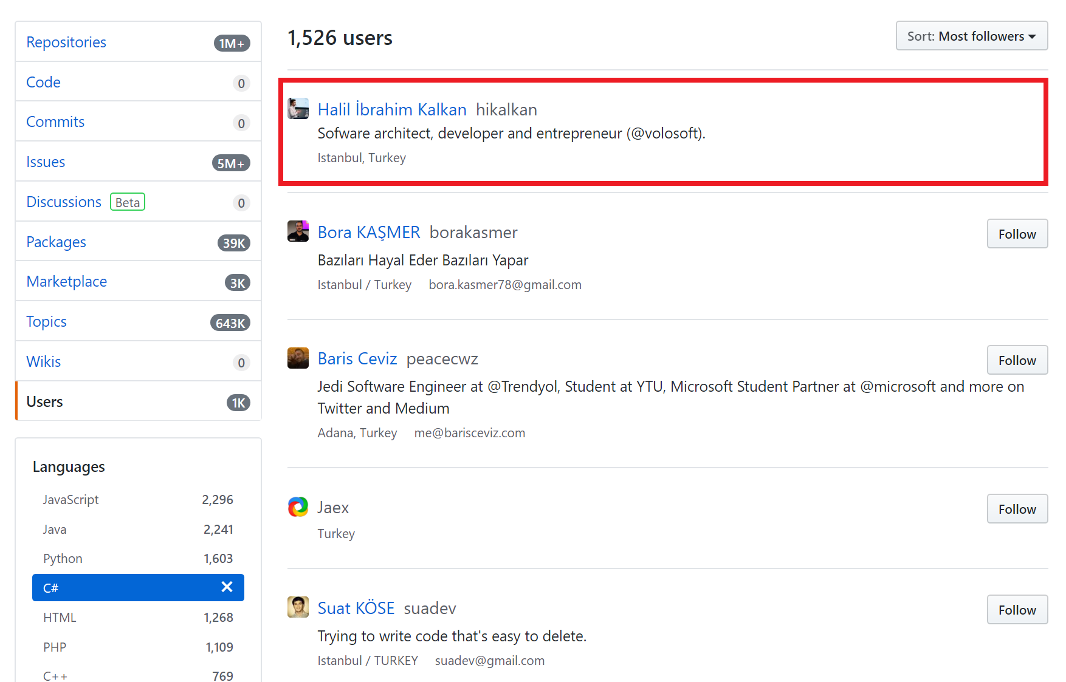

Slide 4
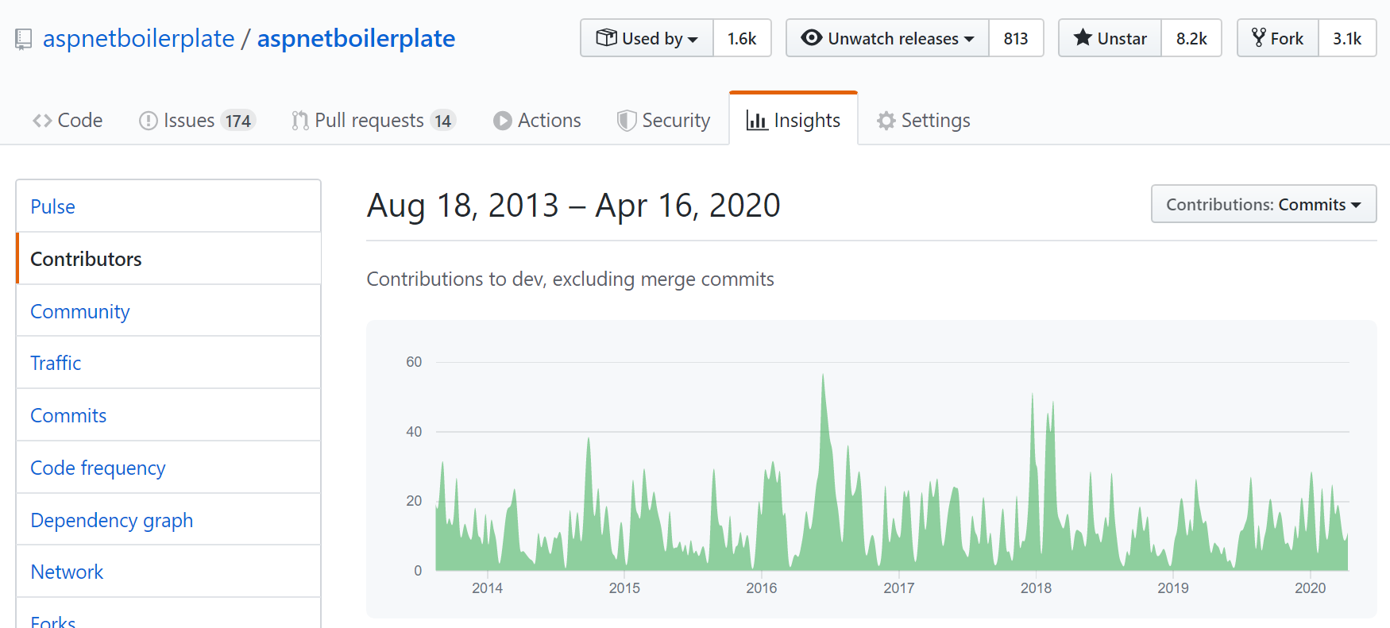
https://aspnetboilerplate.com
8.000+ stars
2,500,000+ downloads

Slide 5

Contributing to the
Bireyler için
Kişisel gelişim
Kariyer
Motivasyon
Firmalar için
Kalitesini göstermek/geliştirmek
Ekip motivasyonu
Yeni personel bulmak
Topluluk oluşturmak

Slide 6
Açık kaynak proje geliştirmek! İyi bir projenin/ürünün özellikleri: kalite!
Her şey İngilizce!
Üst düzey kalite – rekabet zor, herkes burada!
Best practice’lere uygun
Modern sistem ve araçlarla entegre
Dokümantasyon
Destek
Sürekli aktif
Katkıya açık – katkı kılavuzu (contribution guide)
Geri bildirimler
Birden çok katkı sağlayan (contributor)

Slide 7
Writing Code for Humans!
“Any fool can write code that a computer can understand. Good programmers write code that humans can understand.”
Martin Fowler

Slide 8

Writing “Simple” Code!
“Playing football is very simple, but playing simple football is the hardest thing there is.”
Johan Cruyff
Writing code is very simple, but writing simple code is the hardest thing there is!
???

Slide 9
Object Oriented Programming
Interfaces
Classes
Abstraction
OOP
Information Hiding
Inheritance
Encapsulation
Polymorphism

Slide 10
SOLID Principles
S: Single Responsibility Principle
O: Open Closed Principle
L: Liskov Substitution Principle
I: Interface Segregation Principle
D: Dependency Inversion Principle

Slide 11

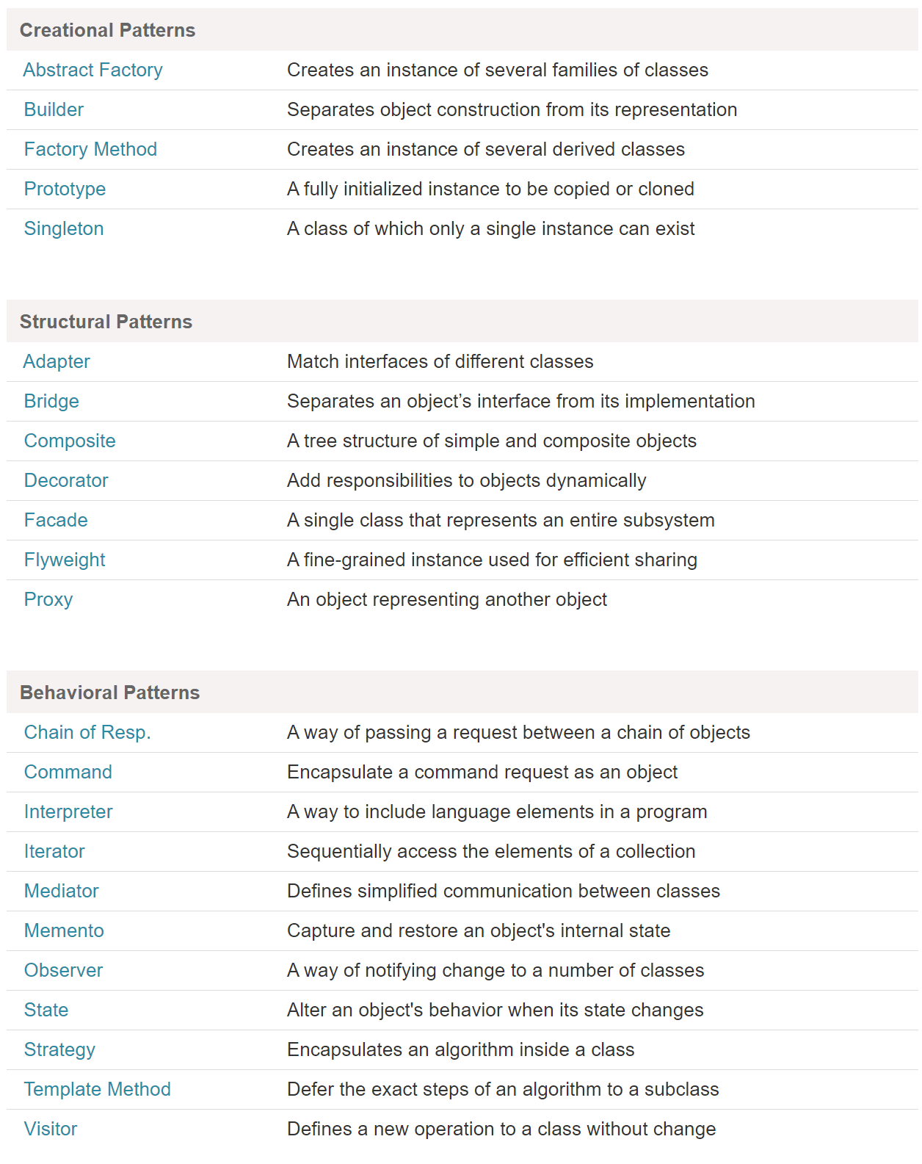
(GoF) Design Patterns
https://www.dofactory.com/net/design-patterns

Slide 12
Refactoring
“When you find you have to add a feature to a program, and the program's code is not structured in a convenient way to add the feature, first refactor the program to make it easy to add the feature, then add the feature.”
Martin Fowler

Slide 13
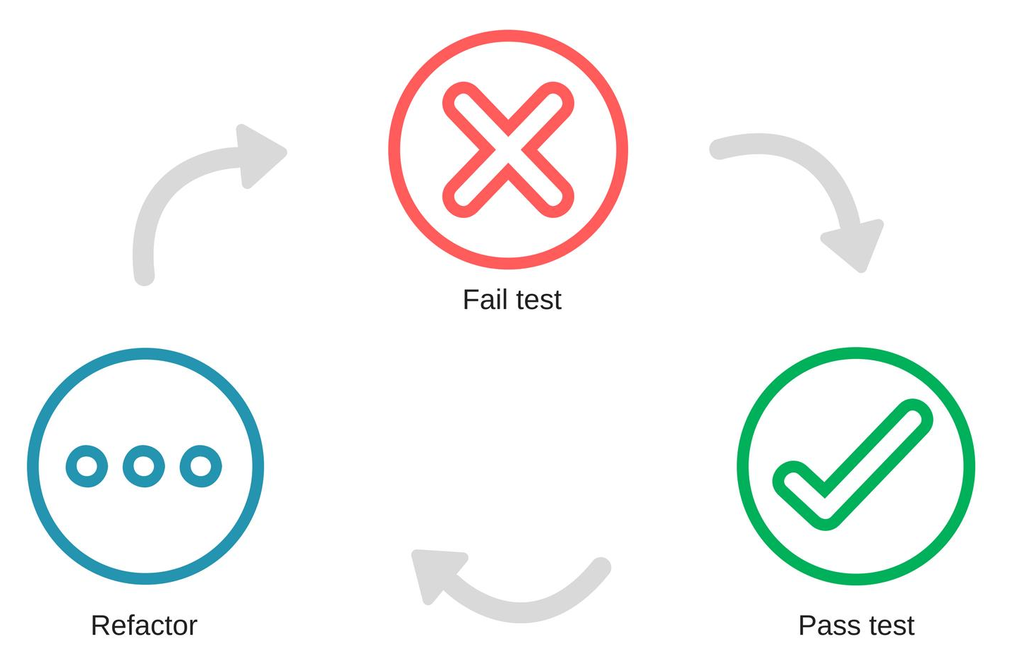
Refactoring & Test Driven Development

Slide 14

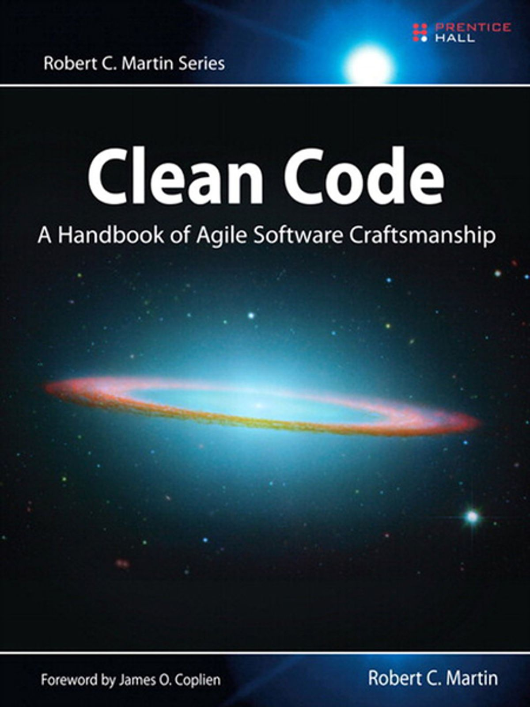
The Ultimate Books!

Slide 15
Refactoring & Testing with the Visual Studio & C#
Show me code!

Slide 16
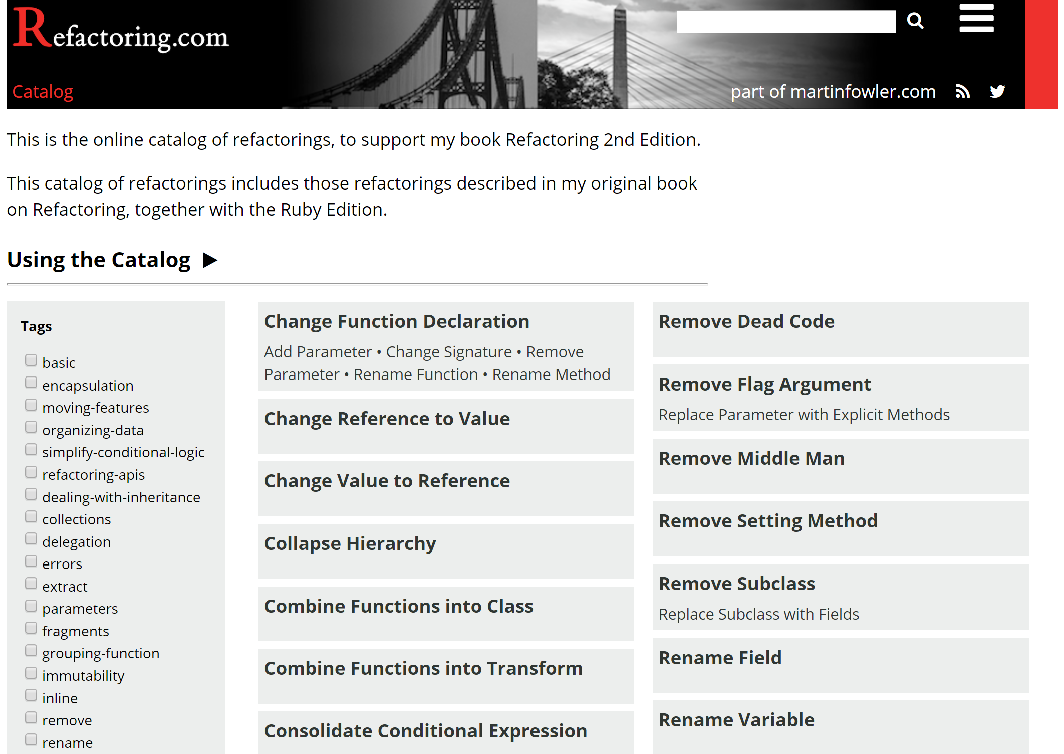
https://refactoring.com/catalog/

Slide 17
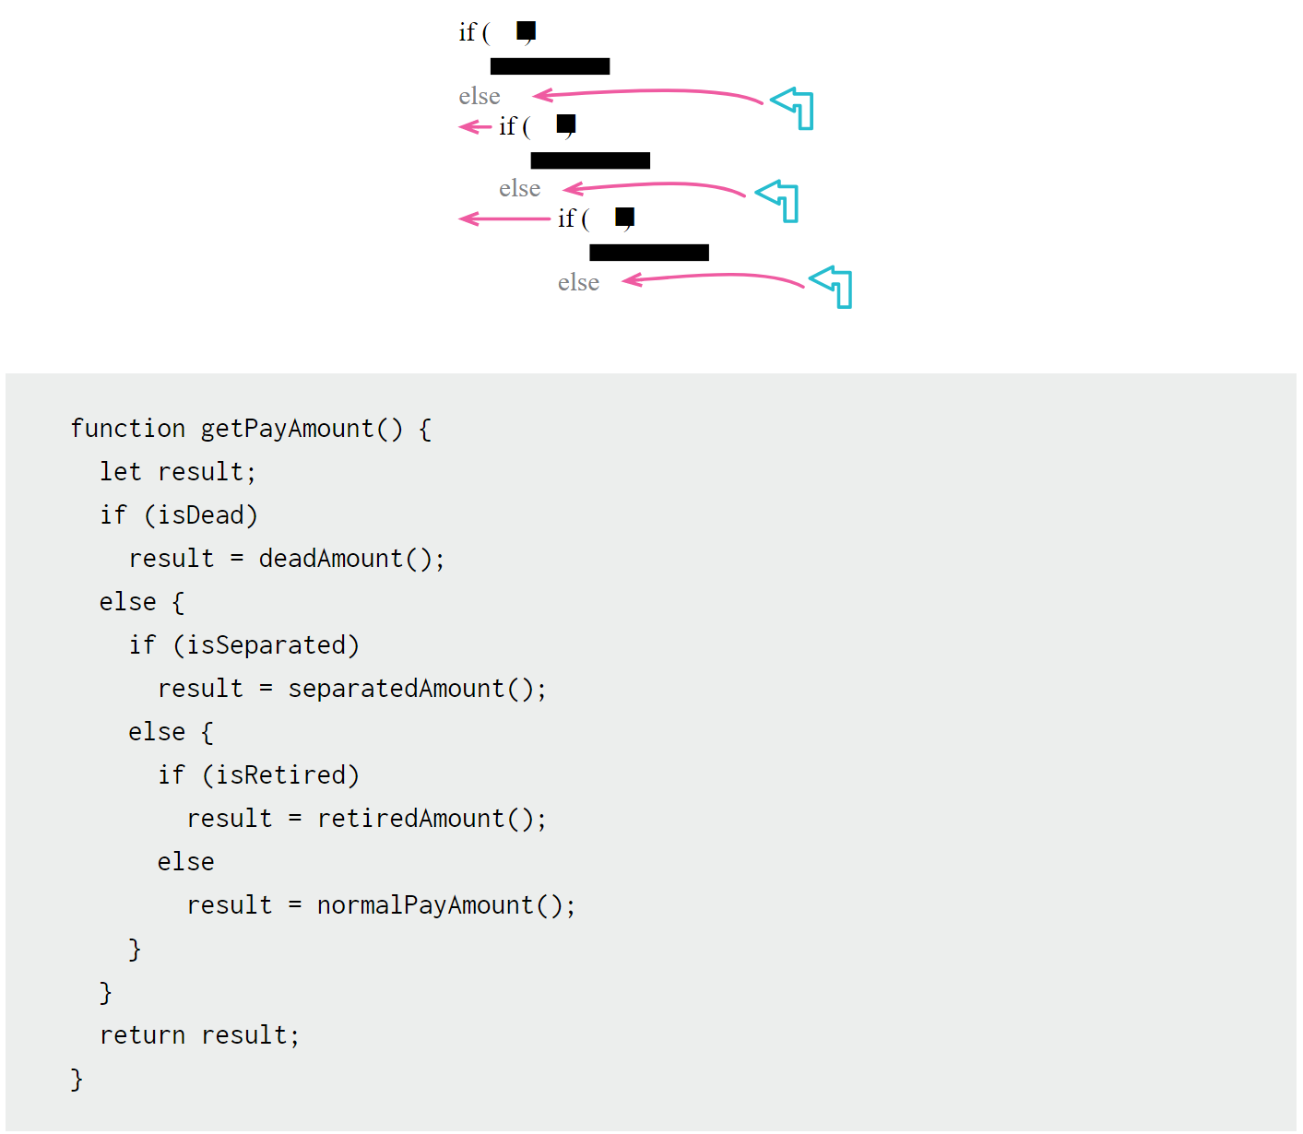
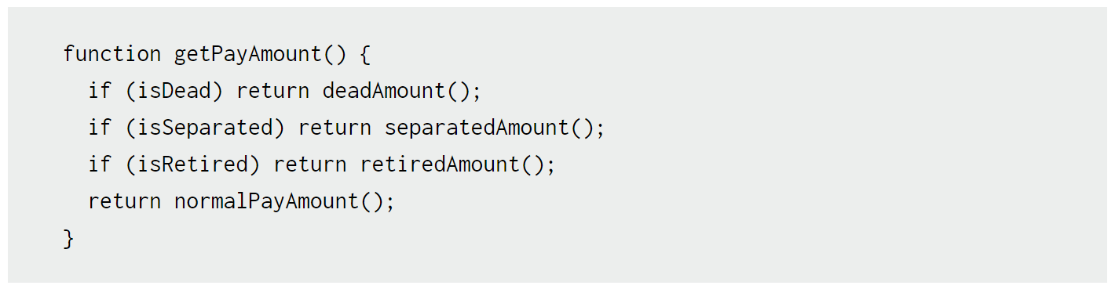
https://refactoring.com/catalog/
Replace Nested Conditional with Guard Clauses

Slide 18
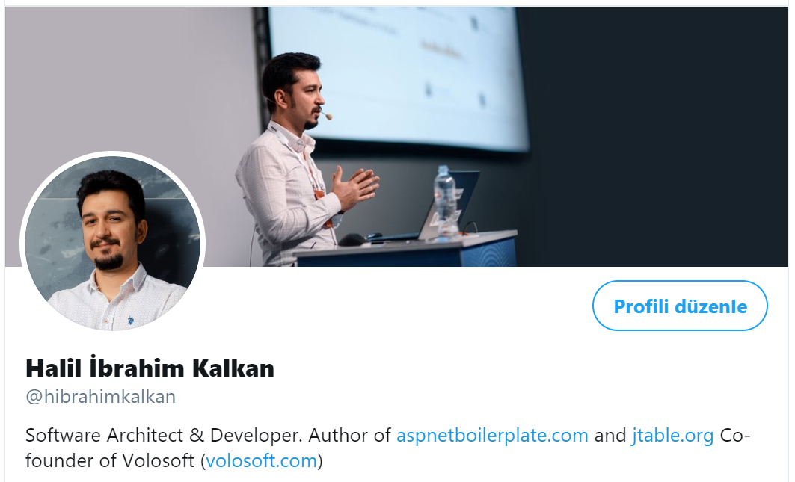
Teşekkürler!
Halil İbrahim Kalkan
http://halilibrahimkalkan.com
GitHub @hikalkan
Twitter @hibrahimkalkan
https://volosoft.com
Sunum: https://github.com/hikalkan/presentations
ABP Framework: https://abp.io https://github.com/abpframework/abp

